Slide 1

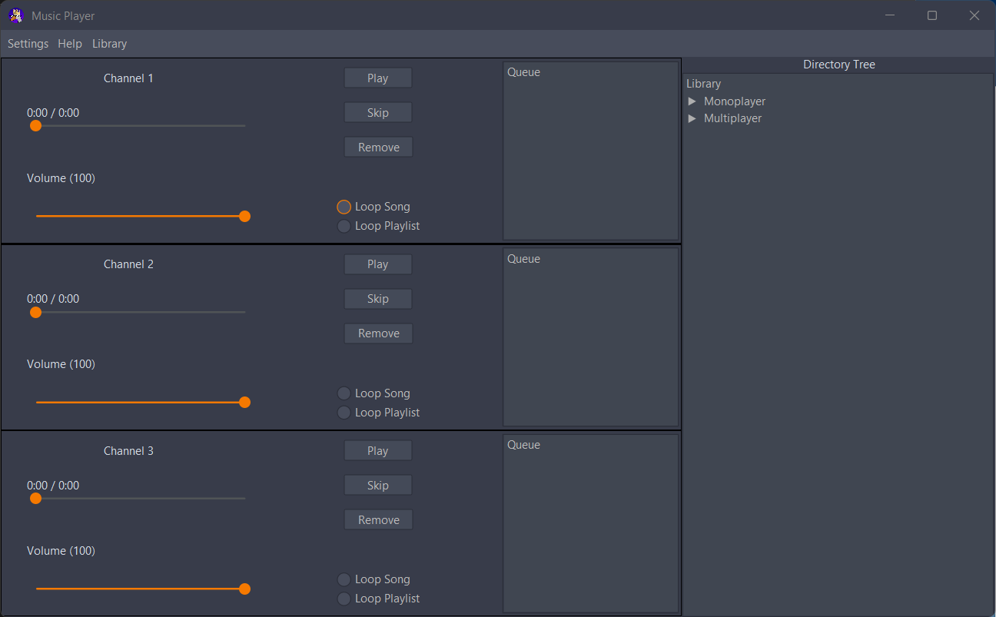
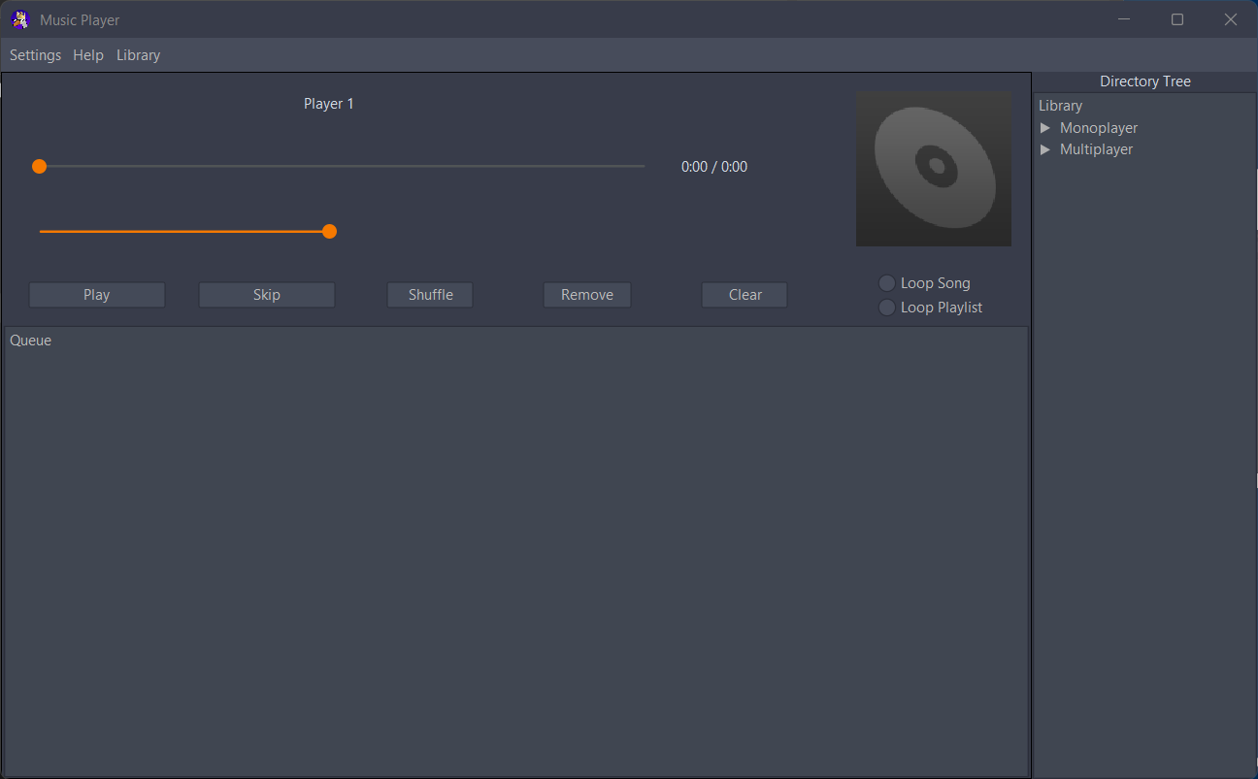
GoosePlayer
A CIS Capstone Project by Joshua Anderson and Camillus Settanni
Washburn University 1700 SW College Ave. Topeka, KS 66621
Goal
Our goal was to create a desktop music player application in Java capable of playing single or multiple tracks at the same time via local memory or external server for use in scenarios such as DnD or . We wanted the player to be customizable with optional themes and playback modes for users.
Finished GoosePlayer UI
Future Features
Future features planned for GoosePlayer include:
Online Radio Support
Playlist creation and deletion
Audio visualizer / spectrum analyzer
Library auto-scan
Design
GoosePlayer is built with Java 17 and Maven.
Maven handles dependency management (FlatLaf, Beads, JAudioTagger, AssertJ-Swing, etc.), compilation, test execution, and packaging — all defined in a single pom.xml file.
Testing & Tools
For testing we used multiple tools to create an elaborate set of regressive tests covering various cases of how the functions were being called and ensuring compliance.
Junit 5 – Assertion and testing framework
AssertJ Swing – UI interaction testing ability
Mockito- Mocking objects handled by the player
Conclusion
Despite lacking prior knowledge of the various core components of GoosePlayer, such as Maven or the dependencies it handles. We successfully created GoosePlayer with its three player modes of Monochannel, Multichannel, and Radio(local).
UI & Themes
We used FlatLaf with its IntelliJ themes add-on to give GoosePlayer2 a modern-looking interface. These additions replaced Swing's older style look-and-feel and provided light, dark, and high-contrast themes, along with rounded corners and modern component styling, for the user's choice.
Key Challenges Overcome
Achieving full multi-channel isolation with independent AudioContexts
Testing complex drag-and-drop interactions across JTree components
Implementing a custom AudioPlayerSpy to count real method calls while playing actual audio

